Slide 1







Enterprise Blockchain Developers (Intermediate)
In support of
Powered By

Slide 2
Outline
Router Design
Links and History
Context
Change class to functional component
Summarize technique implementation process:
Hyperledger Dapp+ChainCode, React Logic, JWT
IPFS Storage
Dive into Proxy
© 2017-2020 SmartMesh Foundation Pte. Ltd. | MeshBox Foundation Pte. Ltd.

Slide 3
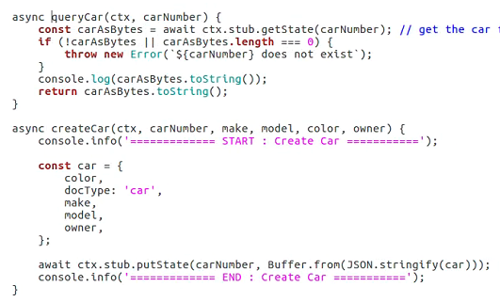
Summarize technique implementation process
1 Hyperledger+Node
Step 1: Start Network
Step 2: Write the chaincode: could init data

Slide 4
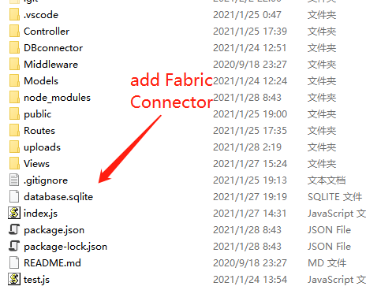
Summarize technique implementation process
1 Hyperledger+Node
Step 3: Deploy Chain Code
Step 4: Write Frontend / Backend
if using Nodejs + ejs, what do we need to modify?

Slide 5
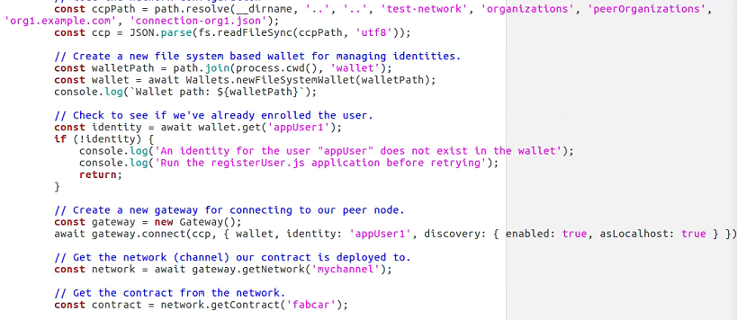
Summarize technique implementation process
1 Hyperledger+Node
Write a class with following constructor
Class FabcarConnector(){
constructor(){
xxxx
}

Slide 6
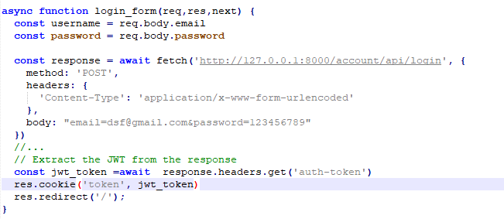
Summarize technique implementation process
1 Hyperledger+Node
Step 5: Passing data from database(chaincode) to controller to view
Dashboard Controller
jwt_token Replaced by result

Slide 7
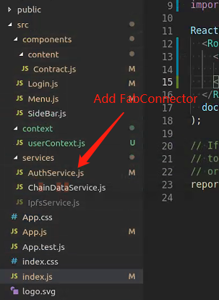
Summarize technique implementation process
2 Hyperledger + React
Step 4: Add Faricconnetor Service

Slide 8
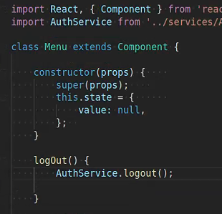
Summarize technique implementation process
2 Hyperledger + React
Step 5: Use the connector
Replace AuthService with the above code, but store data in this.state

Slide 9
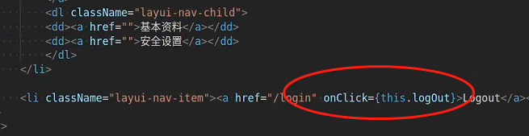
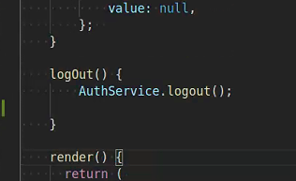
Summarize technique implementation process
3 Reactjs invokes functions (Events Driven)
Step 1: Write Html, and add buttons or links or Forms (Interaction)
Step 2: add onClick / onChange / onSubmit in the html tag to invoke the function
Step 3: Write Specific Logic

Slide 10
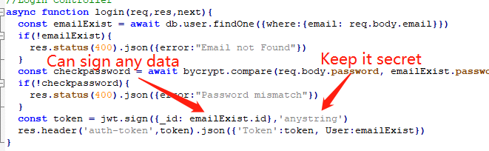
Summarize technique implementation process
4 JWT implementation
Backend side:
Step 1: Write Signup function (has nothing to do with JWT, just store data to DB)
Step 2: Add JWT sign func to login controller

Slide 11
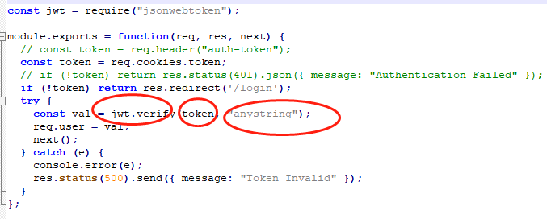
Summarize technique implementation process
4 JWT implementation
Backend side:
Step 3: Write auth middleware
Keep secret to be the same. (This is a seprate process with loging)

Slide 12
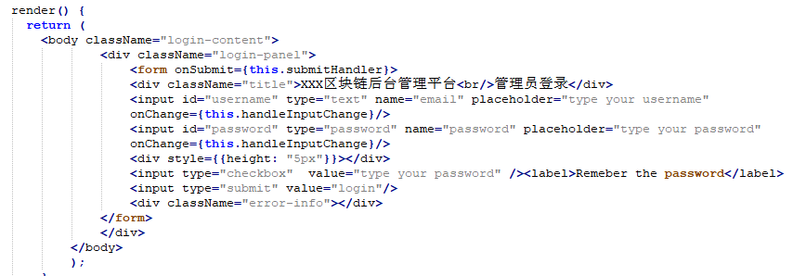
Summarize technique implementation process
4 JWT implementation
Frontend side:
Step 4: Write a login form and a login function in a component to Send the login request to banckend to invoke auth. will get a json in return

Slide 13
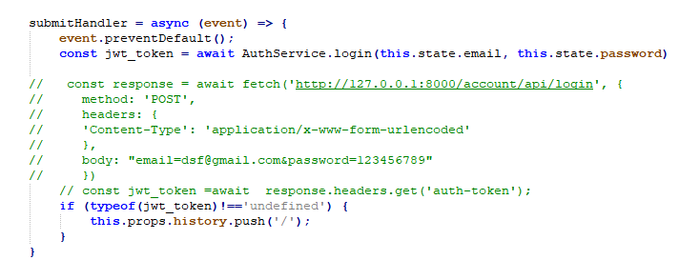
Summarize technique implementation process
4 JWT implementation
Frontend side:
login function

Slide 14
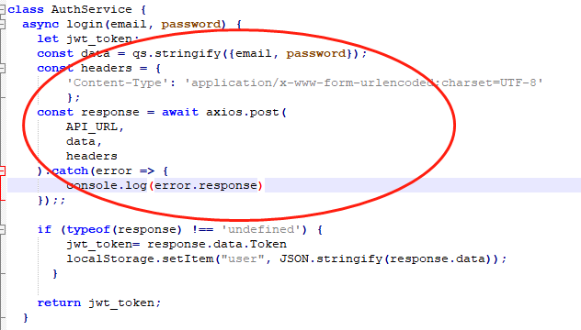
Summarize technique implementation process
4 JWT implementation
Frontend side:
send request to backend

Slide 15
Summarize technique implementation process
4 JWT implementation
Frontend side:
Step 5: either store the token in context and localStorage, using set function
Step 6: write logout using remove function and set the state to rerender the page

Slide 16
React Router Design
Logic:
if not loggedin => goes to login page
other wise => dashboard
swith subpages (define switch for the first level router) example App
secondary subpages (define switch for the second level router)
example contract
note: render according to the level

Slide 17
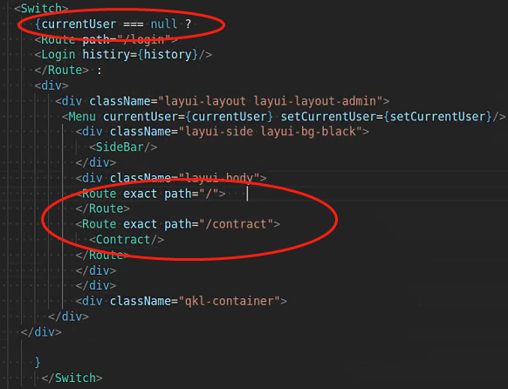
React Router Design

Slide 18
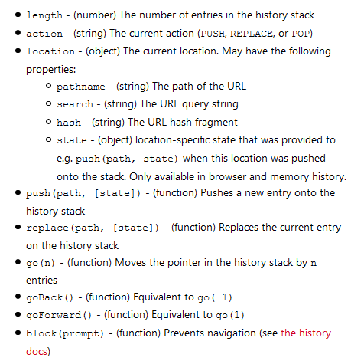
React Links and History
What is link?
Link is the substitution for <a> tag when we implement Router in Reactjs
Used in HTML
What is history?
Used in function to do
redirect
go back etc

Slide 19
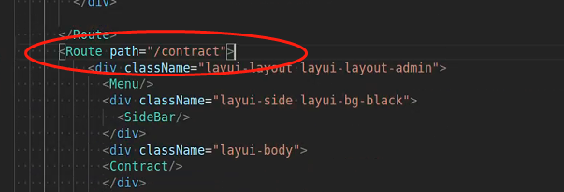
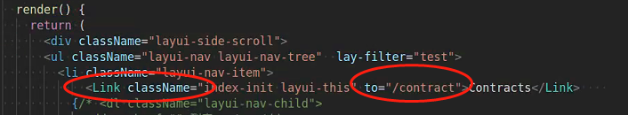
React Links and History
How to implement Link
Step 1: Define a Route in App.js
Add Link in SideBar.js

Slide 20

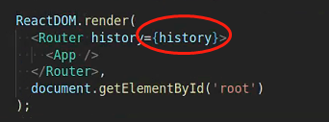
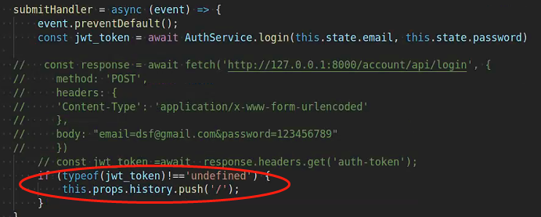
React Links and History
How to implement History
Step 1: Create History
Add intert history as a prop
Call history

Slide 21
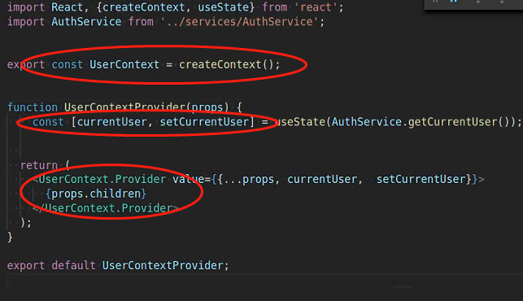
Context
Add currentUserContext
Step 1: Create provider:
create context, create state variables, create provider

Slide 22
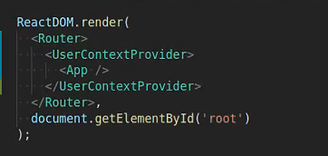
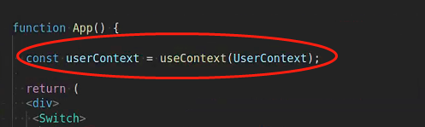
Context
Add currentUserContext
Step 2: Add Wrapper
Step 3 Implement Context

Slide 23
Change Class to Functional Component
Add currentUserContext
Step 2: Add Wrapper
Step 3 Implement Context

Slide 24
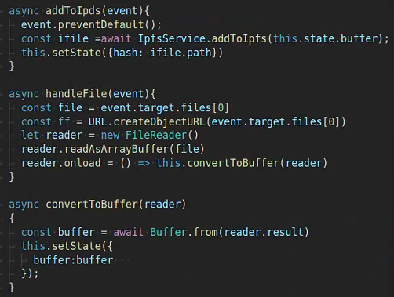
IPFS Storage
(Code Demo)
Step 1: Get file object; Step 2: Conver the file to a ArrayBuffer; Step 3: Store in the state; Step 4: use ipfs.add(buffer) to update

Slide 25
Dive into Proxy (Architect a Solidity Program)
Contractor vs Initializer
Contructor can only be called once when a object gets instantiate
Initializer is a normal function, when make upgradeable contract, we need to use it
initializer can only be initialized once
https://github.com/OpenZeppelin/openzeppelin-sdk/blob/master/packages/lib/contracts/Initializable.sol

Slide 26
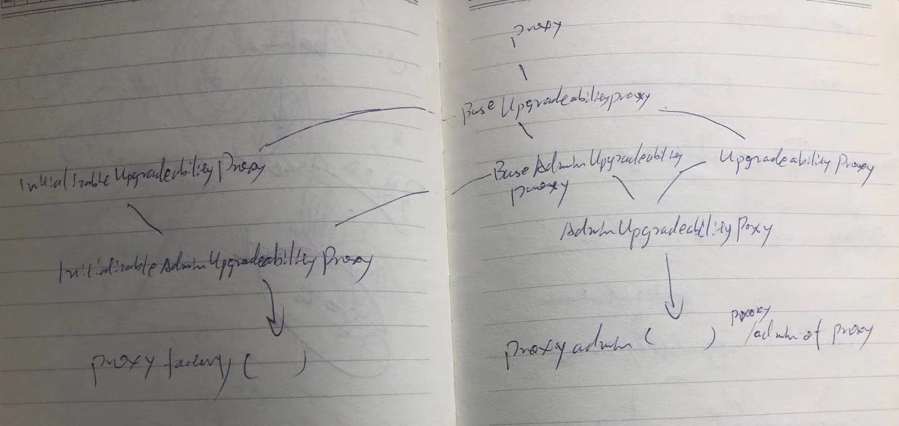
Dive into Proxy (Architect a Solidity Program)
Proxy: fall back and delegateCall
BaseUpgradeabilityProxy: no initializer or contractor, has upgradeto & impl slot

Slide 27
Dive into Proxy (Architect a Solidity Program)
InitializableUpgradebilityProxy: with initializer & Initialize the impl address
BaseAdminUpgradeabilityProxy: Add admin add, no Initializer
UpgradeabilityProxy: with constructor and set the impl slot

Slide 28
Dive into Proxy (Architect a Solidity Program)
InitializableAdminUpgradebilityProxy: Initialize the impl and set admin address
AdminUpgradeabilityProxy: with constructor and set admin add

Slide 29
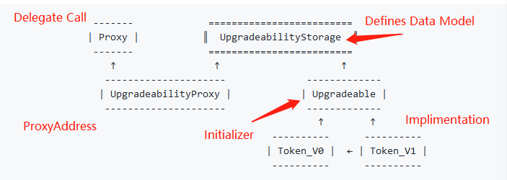
Dive into Proxy (Architect a Solidity Program)
Inherited, Unstructured, External Storage, ProxyFactory and ProxyAdmin
(Code Explain)
Inherited
What does it mean by upgradability? there is a initializer in the smartcontract or there are no constructor / initializer

Slide 30
Dive into Proxy (Architect a Solidity Program)
Drawbacks:
Data Model cannot be changed, can only be updated or add new features
(Code Explain)

Slide 31
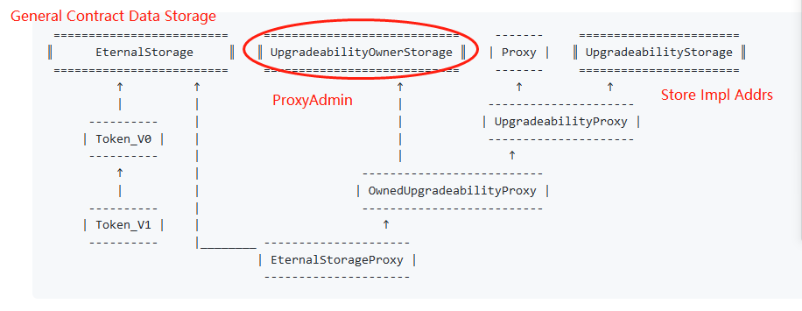
Dive into Proxy (Architect a Solidity Program)
Eternal Storage
(Code Explain)

Slide 32
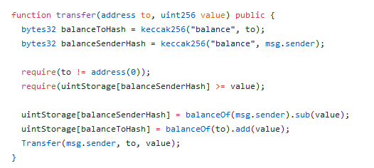
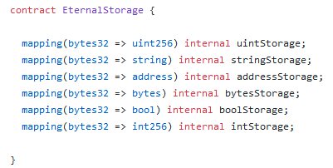
Dive into Proxy (Architect a Solidity Program)
Eternal Storage

Slide 33
Dive into Proxy (Architect a Solidity Program)
Pros:
The actural impl contract's data structure doesn't need to follow the previous impl contract's data structure
Cons:
Hard to write, as we need to extract all the data storing out

Slide 34
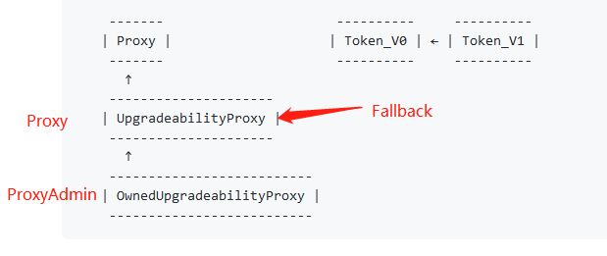
Dive into Proxy (Architect a Solidity Program)
Unstructured
(Code Explain)

Slide 35
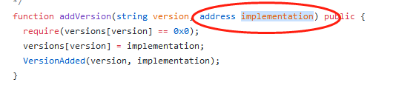

Dive into Proxy (Architect a Solidity Program)
Unstructured
Use pregenerated impl address
Use fixed impl Use pregenerated address
address

Slide 36
Dive into Proxy (Architect a Solidity Program)
ProxyAdmin & ProxyFactory (Code Explain)
Check if IniupgradProxy and AdminUpgradeProx have initializer (Inherited with admin)
Unstructured Storage has contrustor, so can use upgradeto without init data

Slide 37
Code Demo
Upgrade StoreFactory from depolymini to depoly and add Proxy admin

